Slide 1
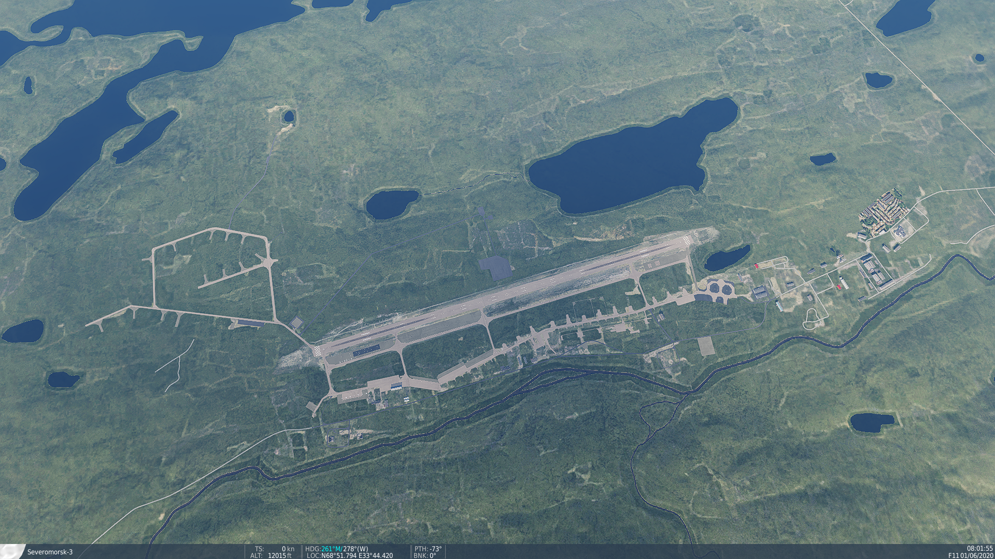
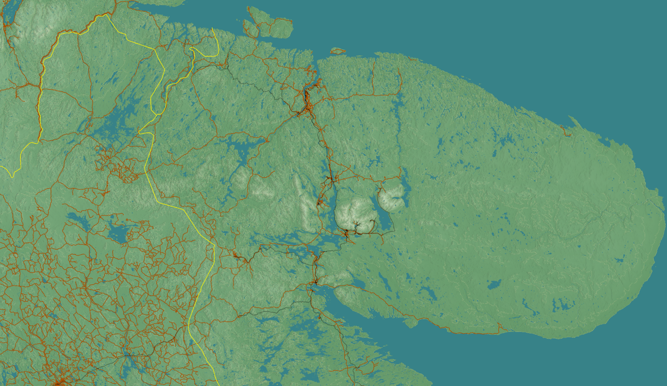
SRNTGT002 SEVOROMORSK-3
N
02
10
DESCRIPTION OF THE DESIRED POINTS OF IMPACT WITH WPN TYPE:
SRNTGT096-A – SCUD Rocket propellant
DPI 1 N 69°04.717' E 33°21.253’/121ft/(1000 Ibs bomb)
DPI 2 N 69°04.698' E 33°21.263’/124ft/(1000 lbs bomb)
SRNTGT096-B – Chemical precursor for WMD production
DPI 3 N 69°04.567' E 33°21.024’/148ft/(1000 Ibs bomb)
DPI 4 N 69°04.556' E 33°21.027’/144ft/(1000 Ibs bomb)
DPI 5 N 69°04.535' E 33°21.033’/138ft/(1000 Ibs bomb)
DPI 6 N 69°04.513' E 33°21.039’/133ft/(1000 Ibs bomb)
DPI 7 N 69°04.506' E 33°21.032’/131ft/(1000 Ibs bomb)
4
5
Collateral Damage Concerns in immediate area.

Slide 2
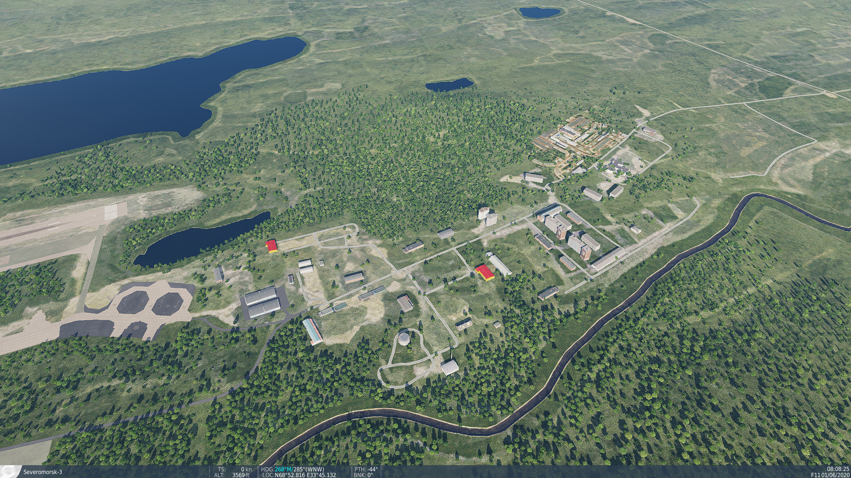
SRNTGT002A COMPLEX WEST
N
DESCRIPTION OF THE DESIRED POINTS OF IMPACT WITH WPN TYPE:
SRNTGT002-A-COMPLEX WEST
DPI 1: N 68°52.951’ E 33°44.232’ /481ft/(500 Ibs bomb)
DPI 2: N 68°52.892’ E 33°44.021’ /499ft/(? lbs bomb)
DPI 3: N 68°52.944' E 33°44.011’/494ft/(? lbs bomb)
DPI 4: N 68°52.860' E 33°44.078’/511ft/(? lbs bomb)
DPI 5: N 68°52.818' E 33°43.895’/525ft/(2x 500 lbs bomb)
DPI 6: N 68°52.884' E 33°43.795’/525ft/(2x 500 lbs bomb)
DPI 7: N 68°52.884' E 33°43.795’/487ft/(2000 lbs bomb)
6
7
5
2
3
4
1
Collateral Damage Concerns in immediate area.

Slide 3
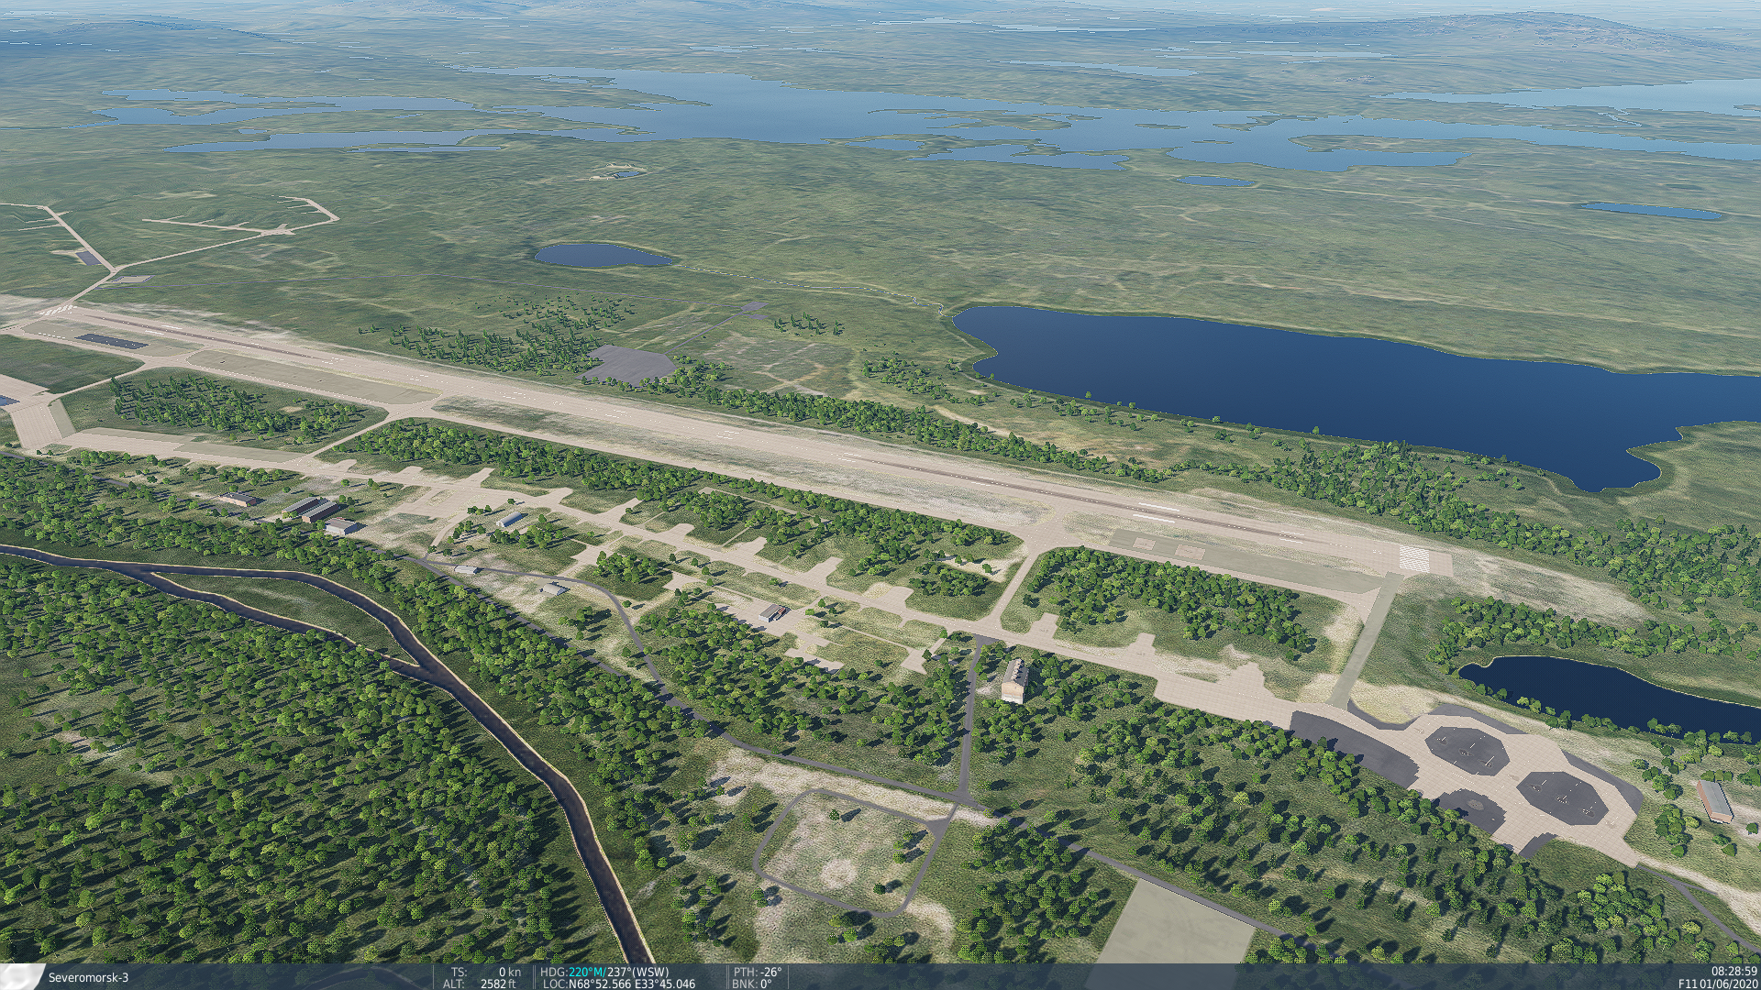
SRNTGT002B AIRCRAFT STAGING AREA
N
DESCRIPTION OF THE DESIRED POINTS OF IMPACT WITH WPN TYPE:
SRNTGT002-A-
DPI 1 N 69°04.717' E 33°21.253’/121ft/(1000 Ibs bomb)
DPI 2 N 69°04.698' E 33°21.263’/124ft/(1000 lbs bomb)
10
4
5
Collateral Damage Concerns in immediate area.

Slide 4
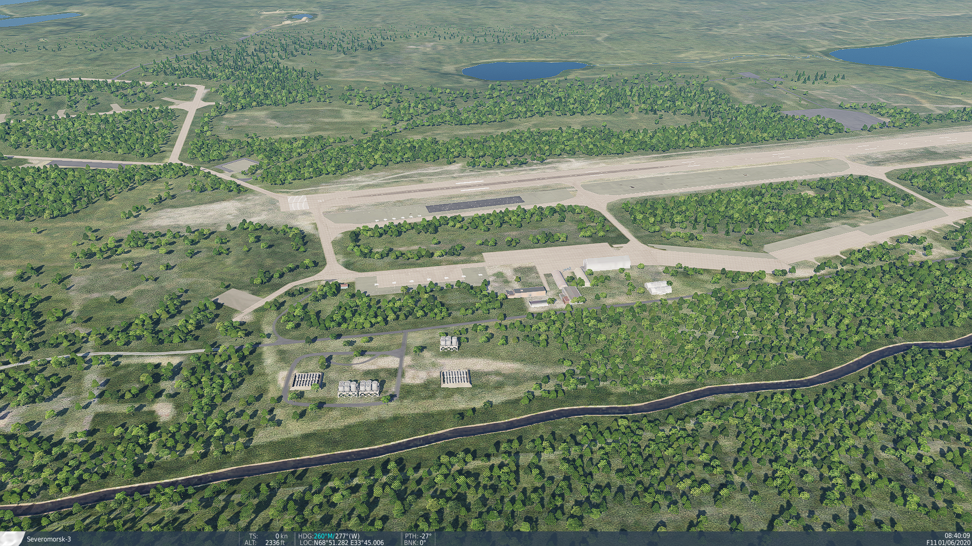
SRNTGT002C COMPLEX EAST
N
DESCRIPTION OF THE DESIRED POINTS OF IMPACT WITH WPN TYPE:
SRNTGT002-A-
DPI 1 N 69°04.717' E 33°21.253’/121ft/(1000 Ibs bomb)
DPI 2 N 69°04.698' E 33°21.263’/124ft/(1000 lbs bomb)
10
4
5
Collateral Damage Concerns in immediate area.

Slide 5
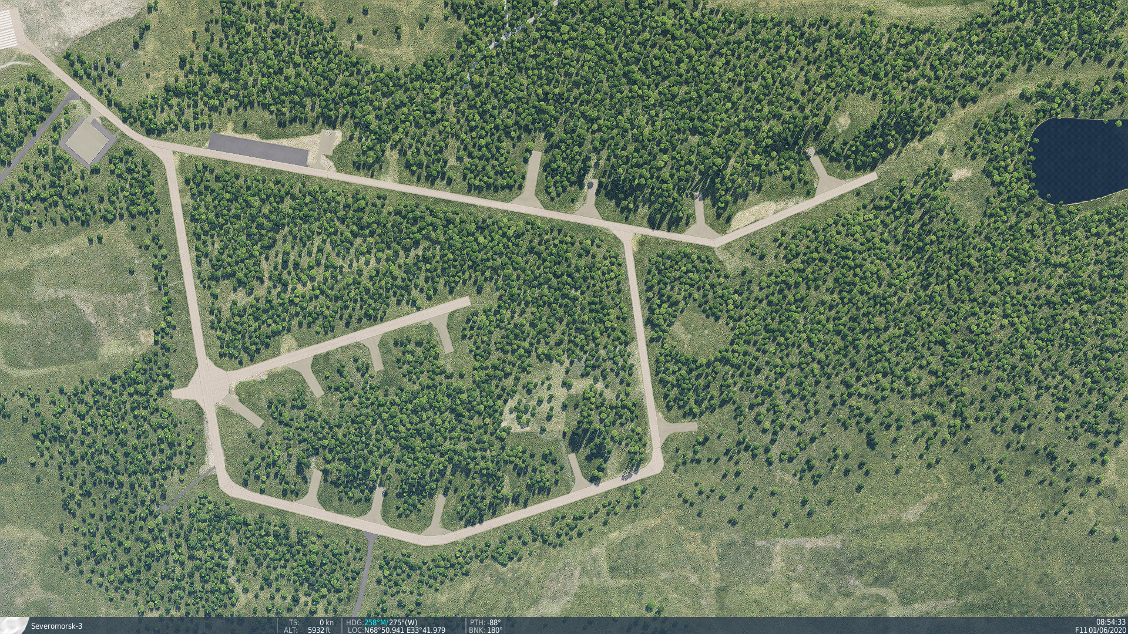
SRNTGT002D AMMO AND FUEL STORAGE
N
DESCRIPTION OF THE DESIRED POINTS OF IMPACT WITH WPN TYPE:
SRNTGT002-A-
DPI 1 N 69°04.717' E 33°21.253’/121ft/(1000 Ibs bomb)
DPI 2 N 69°04.698' E 33°21.263’/124ft/(1000 lbs bomb)
10
4
5
Collateral Damage Concerns in immediate area.

Slide 6
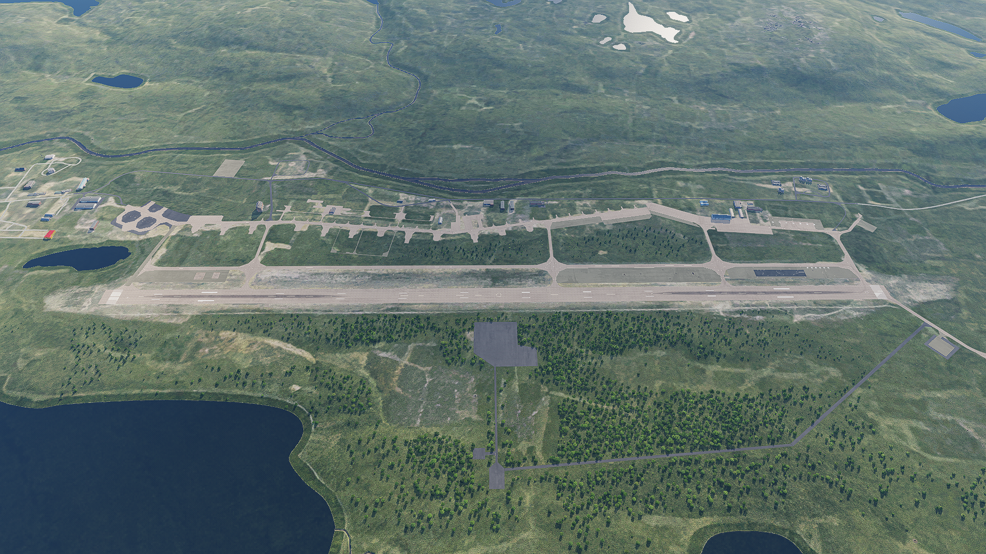
SRNTGT002E RUNWAY AND TAXIWAY
N
DESCRIPTION OF THE DESIRED POINTS OF IMPACT WITH WPN TYPE:
SRNTGT002-A-
DPI 1 N 69°04.717' E 33°21.253’/121ft/(1000 Ibs bomb)
DPI 2 N 69°04.698' E 33°21.263’/124ft/(1000 lbs bomb)
10
4
5
Collateral Damage Concerns in immediate area.

